Slide 1

CHAPTER 4
Text, Code & Knowledge
Generation for Scientists
LLMs as Research Assistants
Literature Synthesis
RAG Systems
Code Generation
Hypothesis Generation
J. Paul Liu, 2026. Generative AI For Science. Leanpub, https://leanpub.com/generativeaiforscience

Slide 2
The Knowledge Synthesis Challenge
Scientific knowledge doubles every few years. PubMed alone adds over 1 million articles annually. No researcher can read, synthesize, and stay current with even a narrow subfield.
The Bottleneck: Human capacity to process information limits the pace of science
WHAT LLMS CAN DO
Synthesize
Generate
Write Code
Insights from thousands of papers in minutes
Hypotheses by identifying gaps and patterns
For data analysis and visualization
Draft
Answer
Translate
Manuscripts and grant proposals
Domain-specific questions with citations
Between scientific disciplines
Goal: Not to replace scientists, but to amplify their capabilities—freeing researchers from information overload to focus on insight, creativity, and discovery.
J. Paul Liu, 2026. Generative AI For Science. Leanpub, https://leanpub.com/generativeaiforscience

Slide 3

PART I
AI-Assisted Literature Review
TRADITIONAL: 40-80 HOURS
AI-ASSISTED WORKFLOW
1. Database search (thousands)
↓
1
Rapid Screening — SciBERT classifier
2. Filter to hundreds
2
Key Point Extraction — Summarization
↓
3. Read abstracts → 50-100
3
Automated Synthesis — LLM integration
↓
4. Deep read 20-30 papers
↓
BENEFITS
5. Extract and synthesize
100× more papers
Cross-discipline
Continuous updates
Reduced bias
LIMITATIONS
Cannot process all relevant literature
2024-2025: GPT-4 systematic reviews achieve 90% sensitivity, 89% accuracy for abstract screening, F1=93 for data extraction
Biased toward recent, cited, English papers
Difficult to find cross-disciplinary links
J. Paul Liu, 2026. Generative AI For Science. Leanpub, https://leanpub.com/generativeaiforscience

Slide 4
PART II
Retrieval-Augmented Generation (RAG)
PROBLEMS WITH STANDARD LLMS
Knowledge Cutoff: Training data ends at fixed date
BUILDING A SCIENTIFIC RAG
Hallucination: Generate plausible but false information
Step 1: Document Processing
Load PDFs, split into chunks (1000 chars, 200 overlap)
RAG solves both by grounding responses in retrieved documents
Step 2: Create Embeddings
Use SciBERT or domain-specific models for better representation
RAG ARCHITECTURE
Step 3: Vector Database
User Query
FAISS, Chroma, Pinecone for efficient similarity search
↓
Retrieve (Vector Search)
Step 4: Query + Generate
↓
Retrieve top-k chunks, augment prompt, generate with citations
Augment with Context
↓
Key Tools: LangChain, FAISS, SciBERT, HuggingFace, LitLLM
Generate + Cite
J. Paul Liu, 2026. Generative AI For Science. Leanpub, https://leanpub.com/generativeaiforscience

Slide 5
2024-2025 ADVANCEMENT
Advanced RAG Techniques
1. Hybrid Search (Dense + Sparse)
GraphRAG (Microsoft 2024)
Combine semantic similarity (FAISS) with keyword matching (BM25). Weights: 70% semantic, 30% keyword.
Constructs knowledge graph from documents, enabling multi-hop reasoning across sources.
Approach
Strength
Weakness
2. Re-Ranking
Retrieve 20 candidates, re-rank with cross-encoder model, return top 5. Significantly improves precision.
Baseline RAG
Fast, simple
Global queries
GraphRAG
Multi-hop
Indexing cost
3. Citation Generation
Use GraphRAG when:
Questions require synthesis across many documents, multi-hop reasoning, or understanding themes/patterns
Number sources [1], [2], etc. Prompt: "Cite sources using brackets after each claim."
J. Paul Liu, 2026. Generative AI For Science. Leanpub, https://leanpub.com/generativeaiforscience

Slide 6
PART III
Hypothesis Generation
LLMs can identify patterns and gaps that suggest new hypotheses:
HYPOTHESIS EVALUATION CRITERIA
1
Gap Analysis
Criterion
Good
Poor
Identify topic combinations not yet explored, methods from other fields, contradictions in findings
Testability
Clear design
Vague
Falsifiability
Can be wrong
Unfalsifiable
2
Cross-Domain Transfer
Novelty
New ground
Replicates
Apply findings from one field to another. Example: CRISPR → climate (engineered algae for carbon capture)
Feasibility
Achievable
Impossible
Impact
Important Q
Trivial
3
Mechanism Proposal
Generate mechanistic explanations with key assumptions, predicted outcomes, and testing methods
Caution: Not all AI-generated hypotheses are good. Always evaluate using these criteria before pursuing.
J. Paul Liu, 2026. Generative AI For Science. Leanpub, https://leanpub.com/generativeaiforscience

Slide 7
2024-2025 BREAKTHROUGH
Autonomous Research Agents
AUTONOMOUS RESEARCH PIPELINE
Fully autonomous systems for end-to-end scientific discovery:
Phase 1: Idea Generation
The AI Scientist (Sakana AI, 2024)
Generates novel research ideas via evolutionary exploration
↓ Filter by novelty
Writes and executes experimental code
Phase 2: Run Experiments
Authors complete papers in LaTeX
↓ Code + Results
Runs simulated peer review
Cost: ~$15 per paper
Phase 3: Write Paper
↓ Self-review
AI Scientist v2 (2025) — Historic Milestone
Phase 4: Iterate/Publish
First AI-generated paper accepted through peer review at ICLR workshop
No human templates
Agentic tree-search
VLM feedback
AI-Researcher (NeurIPS 2025 Spotlight): Scientist-Bench benchmark for evaluating autonomous research systems
J. Paul Liu, 2026. Generative AI For Science. Leanpub, https://leanpub.com/generativeaiforscience

Slide 8
PART IV
Code Generation for Research
AUTOMATED ANALYSIS WORKFLOW
EVOLUTION OF AI CODE GENERATION
1. Inspect NetCDF/data structure
Era
Tool
Capability
↓
1990-2000s
Autocomplete
Basic suggestions
2. Describe task in natural language
2020-21
Codex
Multi-line generation
↓
2022-23
Copilot, AlphaCode
Full functions
3. LLM generates analysis code
2024
GPT-4o, Claude 3.5
Analysis pipelines
↓
2025
Gemini 2.0, DeepSeek R1
Reasoning-enhanced agents
4. Execute and visualize results
SCIENTIFIC USE CASES
Data Loading
Preprocessing
Visualization
Statistics
Simulations
Best Practices
Pipelines
Always review before executing
Test on small data first
Add assertions and error handling
Document AI usage for reproducibility
J. Paul Liu, 2026. Generative AI For Science. Leanpub, https://leanpub.com/generativeaiforscience

Slide 9
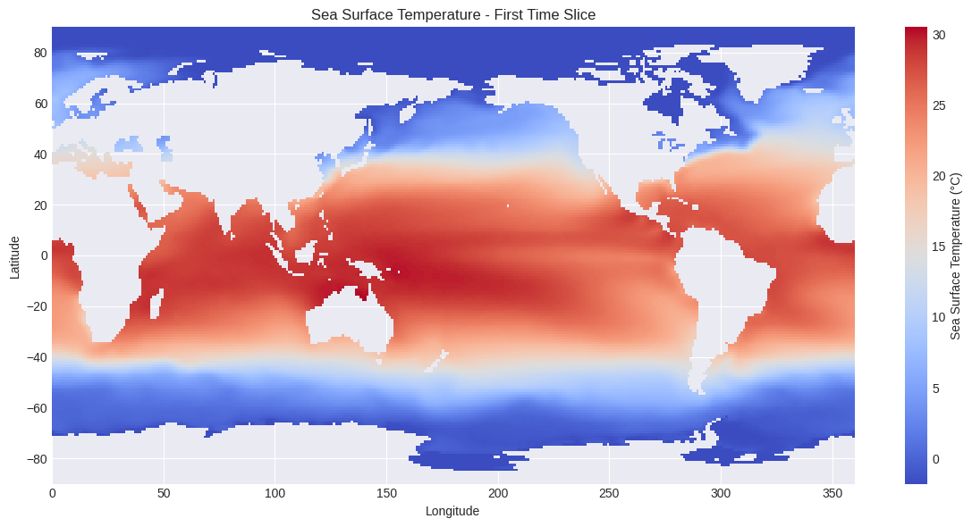
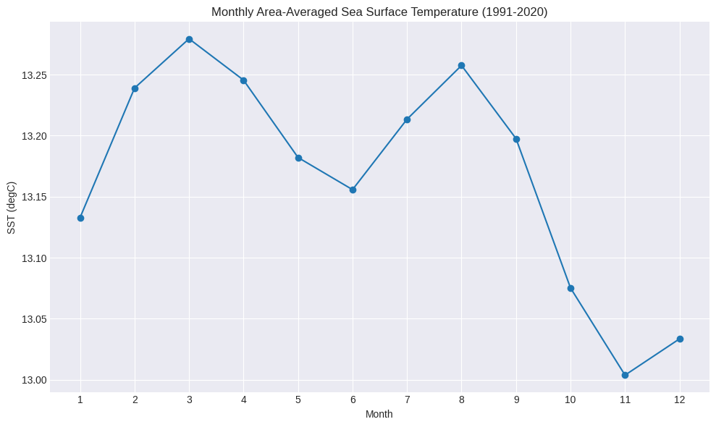
LLM-Generated Analysis: Case Study
NOAA COBE-SST Climatology Data (Figures 4.1-4.2)
FIGURE 4.1: GLOBAL SST MAP
FIGURE 4.2: MONTHLY MEAN SST
Warm (30°C)
Cold (0°C)
Global Sea Surface Temperature
AI-generated code correctly handled NetCDF structure, applied appropriate colormaps, and produced publication-quality visualization.
Bimodal pattern with peaks in March (~13.28°C) and August (~13.26°C), minimum in November (~13.01°C). Used area-weighted averages.
Natural Language Task:
Key Insight: LLMs generate complete, scientifically valid analysis pipelines from natural language—understanding data structure, selecting methods, applying correct techniques.
"Plot global SST for first time step, save to PNG"
J. Paul Liu, 2026. Generative AI For Science. Leanpub, https://leanpub.com/generativeaiforscience

Slide 10
PART V
Scientific Writing Assistance
ETHICAL CONSIDERATIONS
Task
AI Role
Human Role
1. Disclose AI Use: Many journals require it
2. Verify Accuracy: All claims must be verified
Literature Summaries
Draft summaries
Verify accuracy
3. Avoid Plagiarism: Don't paraphrase others' work
4. Maintain Authorship: Intellectual contribution required
Methods Sections
Expand notes
Completeness
5. Check for Bias: Review for hidden assumptions
Results Descriptions
Convert data
Interpretation
Discussion Drafts
Synthesize
Add insight
Example Disclosure Statement:
Grant Proposals
Initial drafts
Personalize
"We used AI language models (GPT-4) to assist with initial drafting of the Methods and Results sections. All AI-generated text was reviewed, fact-checked, and substantially revised by the authors."
Reviewer Response
Draft replies
Final approval
Nature, Science policy: Tools such as ChatGPT cannot be authors—humans must take responsibility for all content.
J. Paul Liu, 2026. Generative AI For Science. Leanpub, https://leanpub.com/generativeaiforscience

Slide 11
PART VII
Domain-Specific LLM Systems
BUILDING SPECIALIZED ASSISTANTS
EXAMPLE: OCEANGPT SYSTEM
Base LLM (GPT, LLaMA, etc.)
↓
Query Modes:
Domain Pre-training (corpus)
explain
Conceptual explanations with lit. refs
↓
code
Generate analysis code (xarray, gsw)
Fine-tuning (task-specific)
↓
data
Search dataset catalog
RAG Integration (literature)
methods
Suggest analytical approaches
↓
Domain-Specific Assistant
System Components:
Paper index (RAG with domain embeddings)
Dataset catalog (NOAA, Copernicus, etc.)
Existing Domain Models:
Code templates (domain-specific libraries)
SciBERT
BioGPT
Galactica
ChemBERTa
J. Paul Liu, 2026. Generative AI For Science. Leanpub, https://leanpub.com/generativeaiforscience

Slide 12
PART VIII
Limitations and Best Practices
KNOWN LIMITATIONS
BEST PRACTICES
Limitation
Mitigation
1. Verification Pipeline
Check consistency, citations, facts
Hallucination
Always verify claims
Training Cutoff
Use RAG with current literature
2. Transparency
Document AI system, prompts, verification
Overconfidence
Request confidence estimates
Citation Errors
Verify all references
3. Continuous Learning
Bias
Critical review of outputs
Collect feedback, improve over time
Domain Gaps
Fine-tune on domain data
4. Code Review
Never execute without understanding
Human-in-the-Loop
AI Generation → Human Review → Revision → Final Approval
"AI assists discovery and implementation; scientists make decisions."
J. Paul Liu, 2026. Generative AI For Science. Leanpub, https://leanpub.com/generativeaiforscience

Slide 13
Key Takeaways
KEY PRINCIPLES
1
Literature Review: Process thousands of papers, identify patterns, synthesize continuously
Always Verify: AI is a tool, not an oracle
RAG Systems: Ground responses in documents, ensure accuracy, provide citations
Use RAG: Ground responses in authoritative sources
2
Review Code: Never execute without understanding
3
Hypothesis Generation: Gap analysis, cross-domain transfer, autonomous research agents
Document: Transparency about AI use is essential
4
Code Generation: Complete analysis pipelines from natural language descriptions
Human Judgment: Scientists make final decisions
5
Scientific Writing: Methods, results, reviewer responses with proper disclosure
The goal is not to replace scientific thinking but to amplify it—freeing researchers from information overload to focus on insight, creativity, and discovery.
J. Paul Liu, 2026. Generative AI For Science. Leanpub, https://leanpub.com/generativeaiforscience

Slide 14
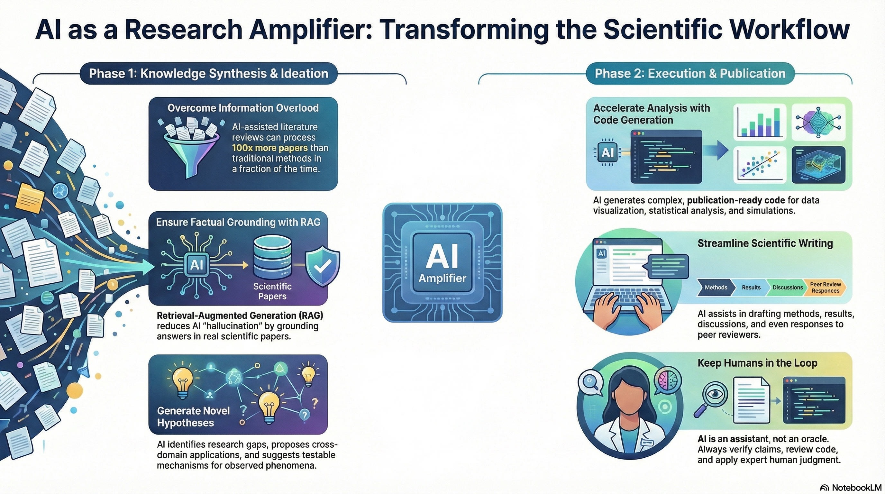
J. Paul Liu, 2026. Generative AI For Science. Leanpub, https://leanpub.com/generativeaiforscience

Slide 15
References and Resources
KEY PAPERS
TOOLS AND LIBRARIES
Lewis et al. (NeurIPS 2020)
LangChain
FAISS
Chroma
SciSpacy
LitLLM
Grobid
RAG for knowledge-intensive NLP tasks
Edge et al. (2024)
Full Working Code:
GraphRAG: Knowledge graph-enhanced retrieval
rewriting.ai/bookcode/ai4sci.php
Lu et al. (2024)
The AI Scientist: Automated scientific discovery
Book Information:
J. Paul Liu, 2026. Generative AI For Science. Leanpub
Chen et al. (2021)
Codex: Evaluating LLMs trained on code
Next Chapter:
Beltagy et al. (2019)
Chapter 5 — Data-to-Data Models: synthetic data, gap filling, upscaling
SciBERT: Pretrained LM for scientific text
J. Paul Liu, 2026. Generative AI For Science. Leanpub, https://leanpub.com/generativeaiforscience

